Slide 1
LU-0007-2024
Checkmat Portland
Conditional Use Permit
Public Hearing: 3/13/2024
Troutdale Planning Commission | Kellogg Room

Slide 2
Staff Presentation

Slide 3
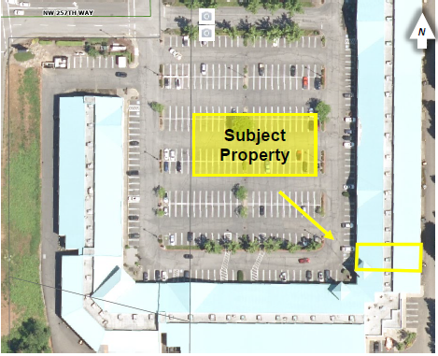
Site Background
Applicant: Antonio Roberto Crivelari Junior
Columbia Gorge Outlets
450 NW 257th Way, Suite 354
Zone: General Commercial (GC)
Overlay: Town Center
Use: Brazilian Jiu Jitsu
Surrounding Uses: varied retail uses

Slide 4
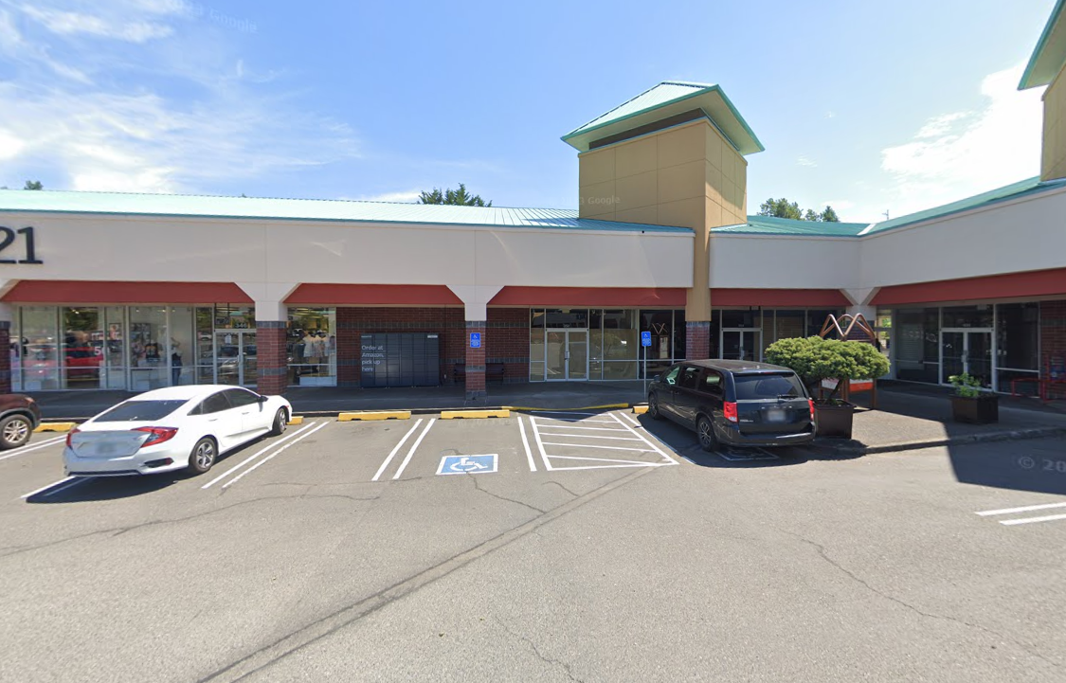
Street View

Slide 5
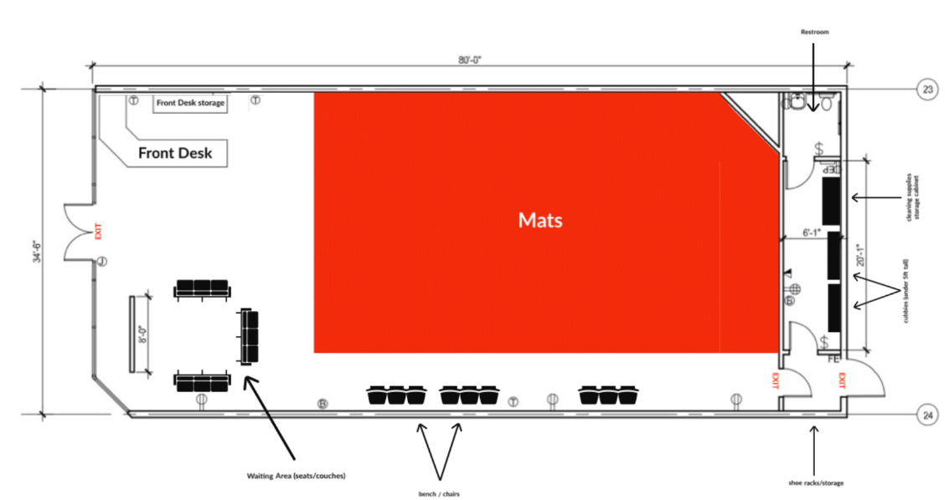
Floor plan

Slide 6
What is being asked of Planning Commission
What is being requested
  A Conditional Use Permit decision for a jiu jitsu studio at suite 354 of the Columbia Gorge Outlets
What is not being requested
  Zoning Change (existing zoning to remain)
  Any new exterior additions, changes to footprint, changes to exterior design/facade, alterations to the off-street parking area.

Slide 7
Applicable Criteria
Comprehensive Plan
Troutdale Development Code (TDC)
  Ch.1 Introductory Provisions
  Ch.2 Procedures for Decision Making
  Sec 3.312 General Commercial (GC)
  Sec. 4.600 Town Center Overlay (no findings/comments received)
  Sec. 6.300 Conditional Use
  Ch.9 Off Street Parking and Loading
  Ch.17 General Provisions
Building and Fire Codes
Public Works Standards

Slide 8
Review Procedure
Type III Quasi-Judicial Procedure
  Public Hearing, PC is the decision-making entity
If there is an appeal...
  City Council
Timeline
  1/09/2024: Applicant applied for a business license
  1/31/2024: Applicant submitted application materials
  2/20/2024: Application deemed complete
  2/22/2024: Notice of Public Hearing sent out to all property owners within 500 feet of the subject property
  3/13/2024: Public Hearing
  If approved….
  Applicant’s business license can be approved

Slide 9
Notification and Summary of Comments
Agency Comments
  City of Troutdale Planning
  City of Troutdale Public Works
  City of Troutdale Building
  Gresham Fire & Emergency Services
  Multnomah County Transportation
Public Comments
  None received
Summary of Comments
  All entities suggest the permit can be issued with conditions of approval

Slide 10
Decision Criteria TDC 6.320
A. The use is listed as a conditional use in the underlying district, or approved by the Planning Commission as similar to conditional uses listed in the underlying district.
FINDING: The proposed use at the subject site is a jiu jitsu studio. Per the Troutdale Development Code (TDC) general definitions TDC 1.020, a Jiu Jitsu studio most closely falls under the ‘recreation facility (active)”. TDC defines active recreation as:
A place or use that contains facilities or features that includes recreational components beyond those of a typical passive park. These amenities include but are not limited to sports fields, sports courts, skateboard facilities, indoor recreation facilities, larger scaled playgrounds, water-play features, dog parks, or other similar amenities where utilization may lead to traffic, lighting, or noise impacts to surrounding areas.
Due to the TDC not having a “gym” or similar use, the jiu jitsu studio most closely resembles an indoor recreation facility and is within the recreation facility (active) use.
The subject property is zoned GC (general commercial). Under the Troutdale Development Code Land Use Table for Commercial Zoning Districts TDC 3.320 lists recreation facility (active) as a conditionally approved use. As such, this criterion is met.

Slide 11
Decision Criteria TDC 6.320
B. The characteristics of the site are suitable for the proposed use considering size, shape, location, topography, existence of improvements, and natural features.
FINDING: the proposed location of the jiu jitsu studio is at 450 NW 257th way, suite 354 at the Columbia Gorge Outlets. This site already exists and is approximately 2763 square feet in size which is a more than adequate size and shape to accommodate the use. The majority of the space will be used for mats, and there will be a front desk and waiting area, seating adjacent to the mats, small storage areas for items related to the use, and a restroom. The existing improvements adequately serve the proposed site plan.
Based on the most recent parking study for the subject property (LU-0015-2019 EV charging installation), 450 NW 257th way provides 840 vehicle parking spaces. At the time of that review, the minimum required parking for 450 NW 247th way is 671 vehicle parking spaces (TDC 9.015). The provided parking well exceeds the minimum required parking by 169 spaces. Despite no trip generation report submittal, the anticipated trip generation of Checkmat Portland is not anticipated to exceed the outlets current parking capacity.
According to the applicant, the location was strategically chosento allow for easy access from I-84, as its anticipated some students and families will travel to the subject site from nearby cities.
There are no concerns related to the topography or natural features of the site that would impact the proposed use. As such, this criterion is met.

Slide 12
Decision Criteria TDC 6.320
C. All transportation systems, public facilities, and public services related to the proposed development have, or can be improved to have, adequate capacity to serve the proposed development at the time of its completion.
FINDING: 450 NW 257th way suite 354 is accessed via NW Graham Rd, an arterial road maintained by Multnomah County, and NW 257th way, a local road maintained by the City of Troutdale. The applicant has not provided a trip generation estimate report. Checkmat Portland’s trip generation is anticipated to have a negligible impact on NW Graham Rd, however Multnomah County has required a trip generation memorandum to be submitted as a condition of approval to confirm the existing transportation systems can accommodate the proposed use.
As for NW 257th Way, this local road was designed and engineered with the Columbia Gorge Outlets in mind. This local road has the capacity to accommodate the traffic generation of a fully occupied outlet mall. Currently, the outlet mall has a number of vacancies. Considering that NW 257th Way can accommodate the traffic of a fully occupied Columbia Gorge Outlet center, and that the outlets are only partially occupied, the trip generation of Checkmat Portland is anticipated to not have a significant impact on NW 257th’s AADT (annual average daily traffic).

Slide 13
Decision Criteria TDC 6.320
C (continued)
In addition to the above accesses, the outlets of 450 NW 257th Way can be accessed via TriMet bus route 77 and 81 who have stops along the intersection of NW Graham Rd and NW 257th Way.
As for the conditional use’s potential impact on public facilities and services, the City of Troutdale Public Works Department was asked to provide comments and conditions for the conditional use. Public Works Director Travis Hultin has provided comments stating there are no comments, conditions, or requirements of this use. Based on this comment we can conclude the existing public systems and facilities are more than adequate to accommodate the proposed conditional use. As such, this criterion is met.

Slide 14
Decision Criteria TDC 6.320
D. The proposed use will provide adequate open space, landscaping, and aesthetic design to mitigate any possible adverse effects on surrounding properties and uses.
FINDING: The proposed use has no open space standards per the TDC, and no open space areas are going to be installed. Therefore, open space, or lack thereof, is creating no adverse effects the surrounding properties or uses.
Landscaping is triggered during construction of new development or modification of parking areas (TDC 9.015, TDC 9.045). No changes are occurring to the footprint or exterior of the suite, nor parking area, therefore landscaping is not applicable to this review.
The aesthetic design of suite 354 is consistent with the aesthetic design of Columbia Gorge Outlets and imposes no adverse effects. As such, this criterion is met.

Slide 15
Decision Criteria TDC 6.320
E. The proposed use, as conditioned, will not cause or result in the creation of a public nuisance including, but not limited to, air, land, or water degradation, noise, glare, heat, vibration, or other impacts that may be injurious to public health, safety, and wellfare.
FINDING: No nuisances are anticipated as a result of the proposed use. Per the applicant’s narrative, “The use will comply with all applicable regulations and guidelines, including those related to noise, air quality, and waste disposal. Past operations at other locations demonstrate a track record of compliance and respect for the community. Therefore, we are confident that our proposed use of suite 354 at CGO [Columbia Gorge Outlets] will not cause any negative impacts on the community or the surrounding properties.” As such, this criterion is met.

Slide 16
Decision Criteria TDC 6.320
F. The proposal satisfies the applicable provisions of this Code.
FINDING: This proposal satisfies the applicable provisions of the Code. As such, this criterion is met.

Slide 17
Staff Recommendation
Staff recommends approval with conditions as outlined in the Findings of Fact.

Slide 18
Conditions of Approval
City of Troutdale Planning Division
Applicant shall be required to satisfy the comments made by review entities included in the corresponding staff report or shall work with Staff to reach an agreement between the parties.
The approval of case file LU-0007-2024 shall expire automatically two (2) years from the effective date of the decision unless the approval is enacted either through construction, establishment of use, or recordation of plat or survey within the specified time period. The effective date of the decision shall be the date of the Notice of Decision, unless such decision is appealed.
Gresham Fire & Emergency Services
A permanent address will be required on the building; the suite number must be indicated on the main entrance and the secondary access for identification. Address must be minimum 6’’ in height and in color contrasting from its background per Gresham Fire Addressing Policy OFC 505.
Each public or private fire hydrant used for fire flow for this property shall have a 5-inch Storz adapter with National Standard Threads installed on the 4 ½ -inch fire hydrant outlet. The adapter shall be constructed of high strength aluminum alloy, have a Teflon coating on the seat and threads, and use a rubber gasket and two (2) set screws to secure it in place. The adapter shall be provided with an aluminum alloy pressure cap. The cap shall be attached to the hydrant barrel or Storz adapter with a cable to prevent theft of the cap. Adapter shall be Harrington HPHA50-45NHWCAP or equal approved by Gresham Fire.
Proposed mats will need to meet flame spread requirements of chapter 8 in the OSSC/OFC.
Multnomah County Transportation Division
Submit a trip generation memorandum or a traffic impact study, prepared by a professional engineer registered in the State of Oregon, to estimate the transportation impact from the proposed development.

Slide 19
Public Testimony

Slide 20
Public Testimony
Order of Testimony
Applicant
Proponents
Opponents
Neutral Parties / Clarifications
Applicant Response/Rebuttal
Requests for additional time
Reminder:
All testimony raised must be sufficiently clear and specific to allow PC and other parties to respond.
Failure to raise an issue during this public hearing may invalidate a future appeal based on that issue.

Slide 21
Fin

